Slide 1

Heart Disease Diagnostic Analysis
Report By: Aditya Chikte

Slide 2
Introduction
Health data analysis is indispensable in modern healthcare, offering invaluable insights into disease trends, treatment efficacy, and population health. By deciphering complex datasets, healthcare professionals can make informed decisions, optimize resource allocation, and drive evidence-based practices.
From enhancing disease surveillance to guiding public health policies, health data analysis plays a pivotal role in advancing healthcare delivery and improving patient outcomes.

Slide 3
Objectives
Conduct comprehensive exploratory data analysis to understand the distribution of heart disease rates, demographics, and other relevant factors.
Utilize various visualization techniques to illustrate key insights and trends in heart disease diagnostic data.
Train machine learning models to predict heart disease diagnosis, evaluate their performance, and select the best-performing model.
Develop an interactive dashboard to visualize and communicate the analysis results effectively.
Derive actionable insights from the analysis to inform healthcare decision-making and future preparedness strategies.

Slide 4
Project Overview
A. Dataset Detail:
Source: The dataset has been provided by Unified Mentors and the file name was “Heart Disease Data.csv”.
Format: CSV (Comma-Separated Values)
Size: 1025
B. Domain: Health Care
C. Technology and tools used:
Python: Used for data preprocessing, analysis, modeling and visualization.
Google Colab: Utilized as the primary development environment for running Python code

Slide 5
Methodology and Process
Data Extraction and Loading
Data Cleaning and Preprocessing
Exploratory Data Analysis (EDA)
Model Training and Evaluation
Dashboard Development
Insights and Conclusion
Summary

Slide 6
Data Extraction and Loading
The dataset has been provided by Unified Mentors in a CSV format.
By using the gdown library, we extracted this dataset file.
Using the pandas library, the extracted file was loaded into the pandas dataframe for further processing.

Slide 7
Data Cleaning and Preprocessing
The dataset was examined for any missing values, but no missing values were found.
For numerical columns (‘age’, ‘trestbps’, ‘chol’, ‘thalach’, ‘oldpeak’), missing values were replaced with the median of each respective column to preserve central tendency and mitigate the impact of outliers.
For categorical columns (‘sex’, ‘cp’, ‘fbs’, ‘restecg’, ‘exang’, ‘slope’, ‘ca’, ‘thal’), missing values were filled with the mode values to maintain the distribution of categorical variables.

Slide 8
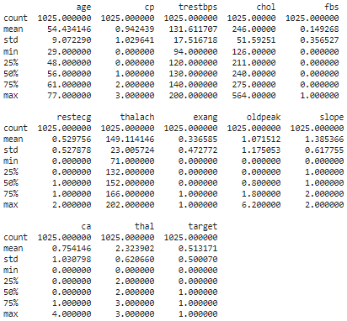
Exploratory Data Analysis (EDA)
Calculated mean, standard deviation, and quartiles for numerical features.

Slide 9
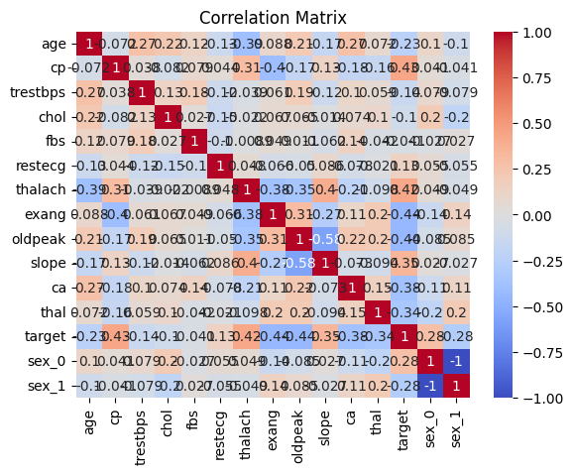
Exploratory Data Analysis (EDA)
Examined linear relationships between features using correlation matrices and heatmaps.

Slide 10
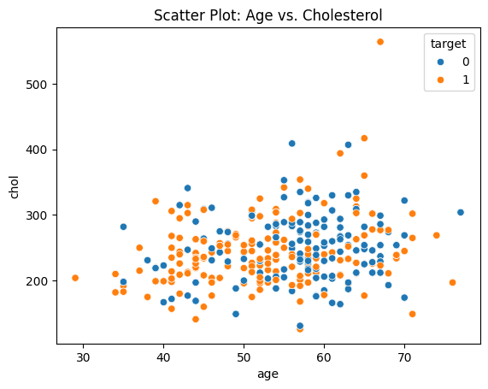
Exploratory Data Analysis (EDA)
Employed histograms, scatter plots, pair plots, and box plots to identify patterns and distributions in the data.

Slide 11
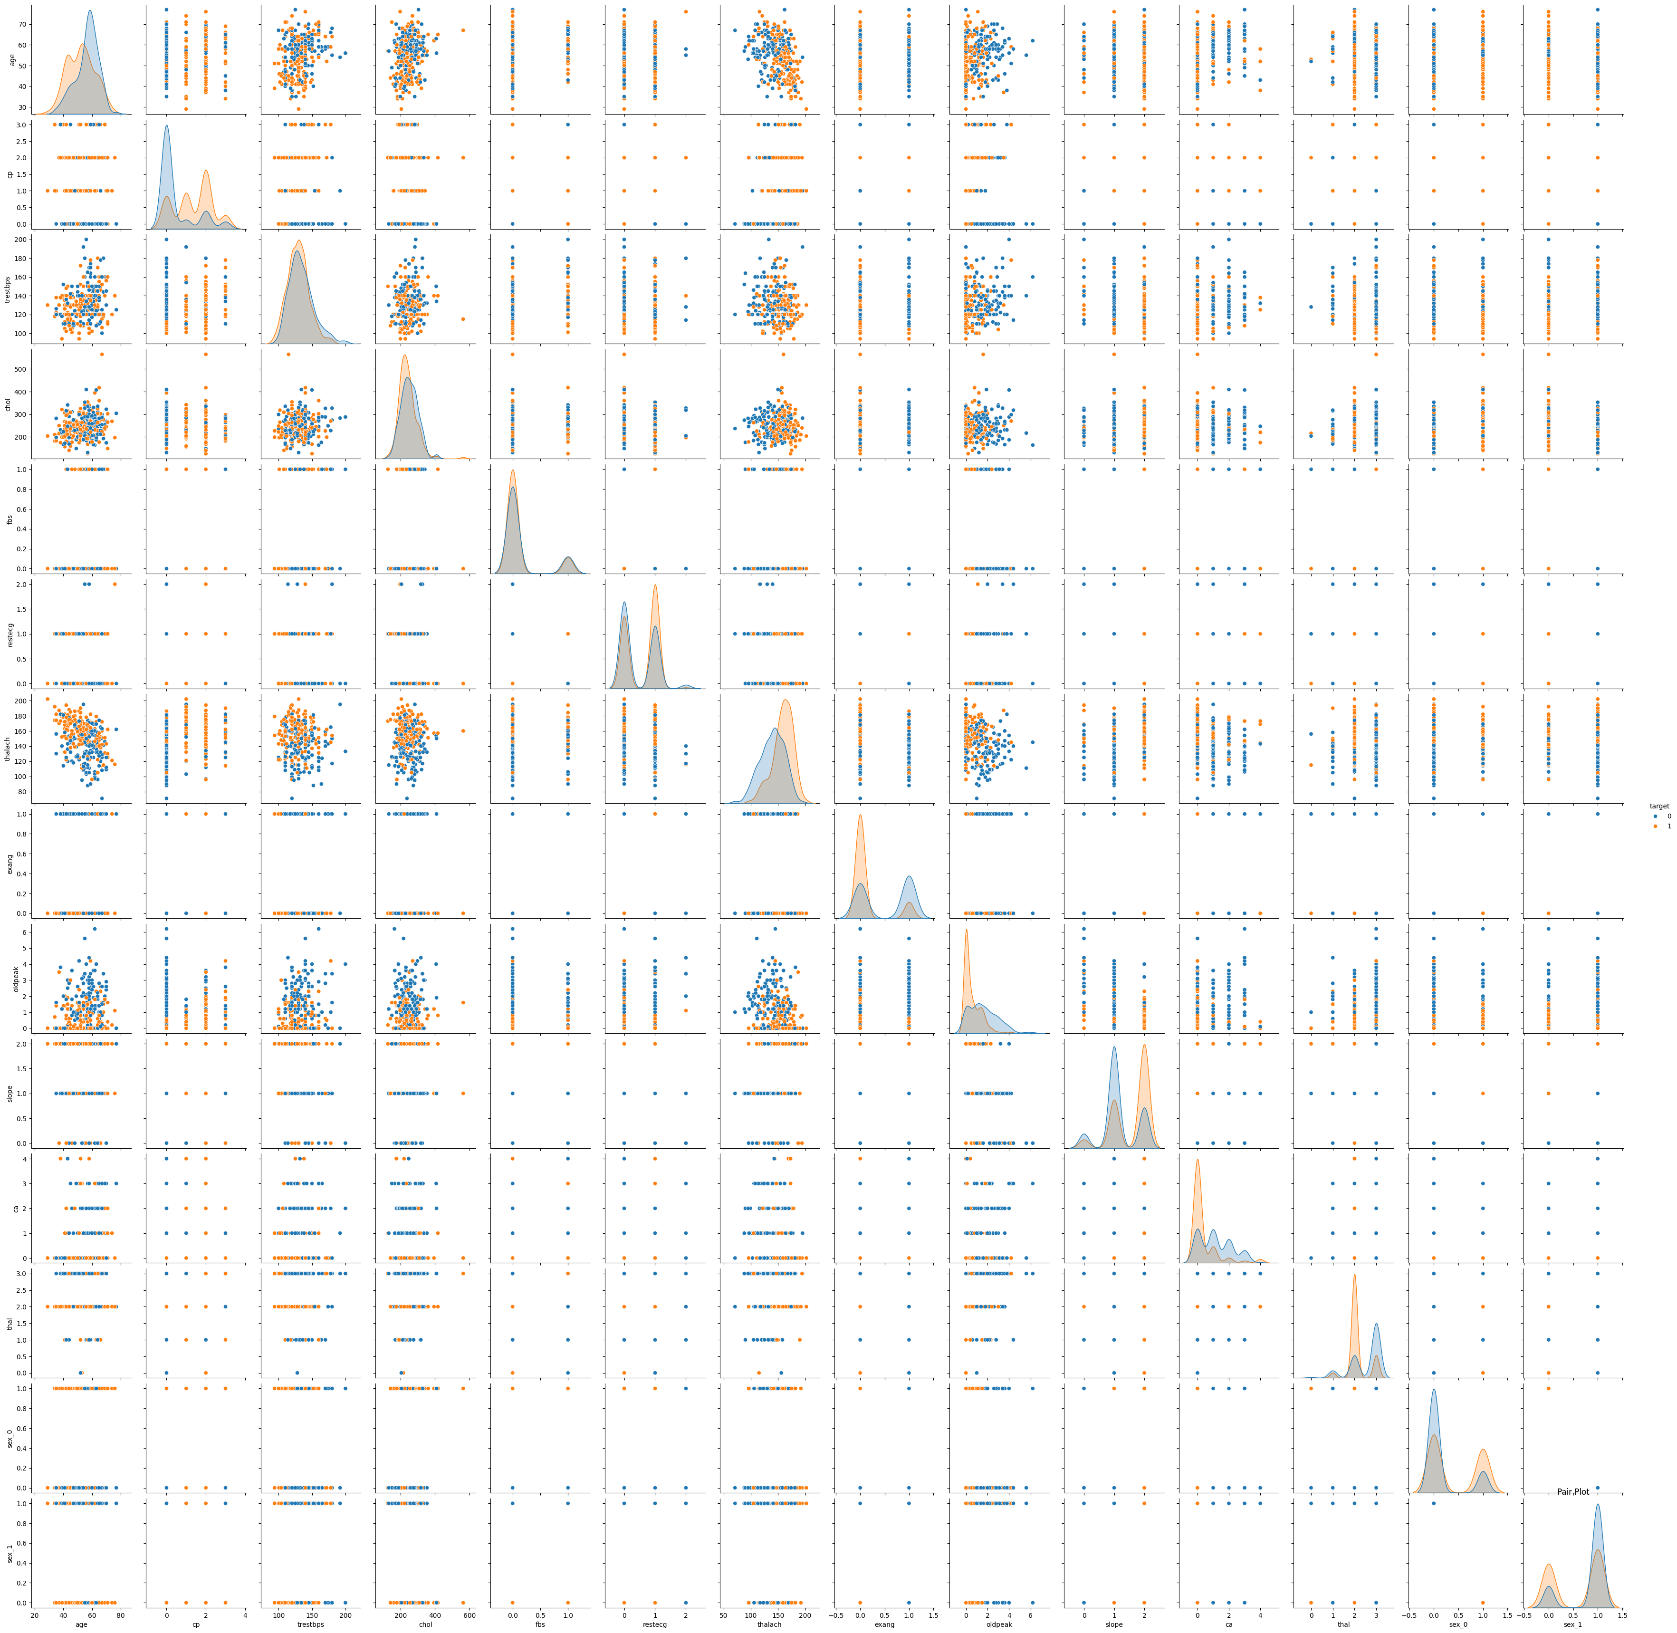
Exploratory Data Analysis (EDA)
Utilized Matplotlib, seaborn, Plotly, and Plotly Express for visualization.

Slide 12
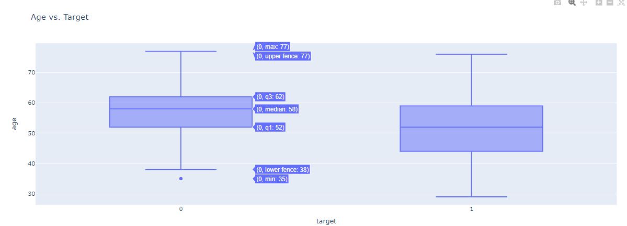
Exploratory Data Analysis (EDA)

Slide 13
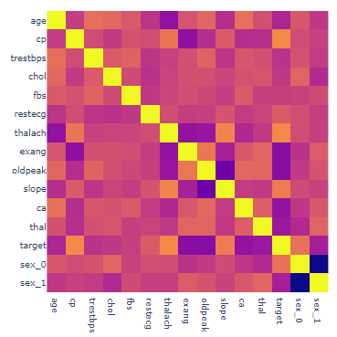

Exploratory Data Analysis (EDA)
Explored correlations between features using correlation matrices or heatmaps.

Slide 14

Model Training and Evaluation
Partitioned the dataset into training and testing sets using a ratio of 80:20.
Utilized a Random Forest Classifier to train the model for heart disease prediction.
Implemented Logistic Regression as an alternative model for heart disease diagnosis.
Assessed model performance using accuracy metrics, including precision, recall, and F1-score.

Slide 15
Dashboard Development
Developed a Dash application to create an interactive dashboard using the plotly dash library.
Designed the dashboard layout with HTML components and Dash core components.
Integrated a dropdown menu to select features for visualization.
Incorporated two graph components to display histograms and box plots dynamically based on user-selected features.
Added a range slider for age selection to filter data for visualization.

Slide 16
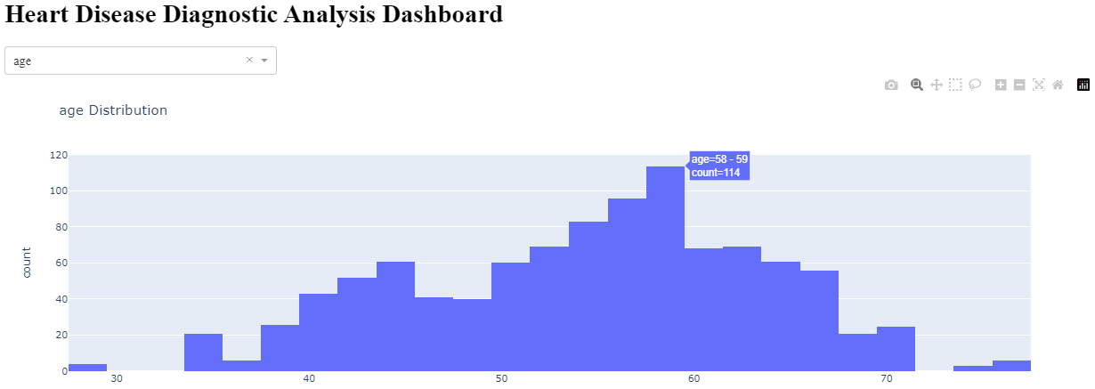
Dashboard Development
Dashboard Interface:

Slide 17
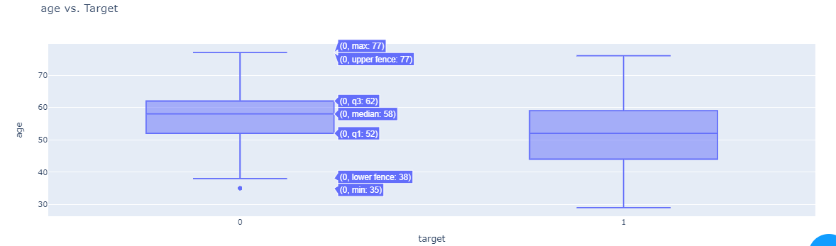
Dashboard Development
Dashboard Interface:

Slide 18
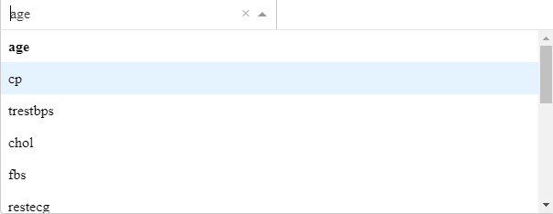

Dashboard Development
Feature Selection:
Range Selection Bar:
Toggles & buttons:

Slide 19
Insights
The age of patients ranges from 29 to 77 years, with a mean age of approximately 54.43 years and a standard deviation of 9.07 years.
The majority of patients experienced chest pain (cp), with the distribution skewed towards lower values. The mean value is approximately 0.94.
The average resting blood pressure is around 131.61 mm Hg, with a standard deviation of 17.52 mm Hg. The minimum and maximum values are 94 mm Hg and 200 mm Hg, respectively.
The mean cholesterol level is 246 mg/dl, with a standard deviation of 51.59 mg/dl. Cholesterol levels range from 126 mg/dl to 564 mg/dl.

Slide 20
Insights
Approximately 14.93% of patients had high fasting blood sugar (fbs), as indicated by a value of 1.
The distribution of resting electrocardiographic results is fairly evenly distributed, with a mean value of approximately 0.53.
The average maximum heart rate achieved is 149.11 beats per minute (bpm), with a standard deviation of 23.01 bpm.
About 33.66% of patients experienced exercise-induced angina, as indicated by a value of 1.
The mean value of ST depression induced by exercise relative to rest is approximately 1.07, with a standard deviation of 1.18.

Slide 21
Insights
The majority of patients have a slope value of 1, indicating down sloping, followed by a value of 2, indicating flat.
The mean number of major vessels is approximately 0.75, with a standard deviation of 1.03.
The majority of patients have thalassemia type 2, followed by type 3.
Approximately 51.32% of patients were diagnosed with heart disease, indicating a balanced dataset with roughly equal instances of positive and negative cases.

Slide 22
Conclusion
The project successfully conducted exploratory data analysis, data cleaning, and preprocessing of heart disease diagnostic data.
Machine learning models were trained to predict heart disease diagnosis with considerable accuracy.
An interactive dashboard was developed to visualize key insights and trends from the data.
Through this project, valuable insights were derived regarding demographic patterns, clinical indicators, and predictive factors associated with heart disease.
These findings provide actionable insights for healthcare professionals to enhance diagnostic processes and inform future healthcare strategies aimed at mitigating the impact of heart disease.

Slide 23
Summary
The dataset comprises individuals across a wide age range, with an average age of approximately 54 years. This suggests that heart disease is not limited to any specific age group and affects individuals across various stages of life.
Key clinical parameters such as resting blood pressure, cholesterol levels, and maximum heart rate vary considerably among patients. Understanding these variations is crucial for accurate diagnosis and treatment planning.
Factors such as high fasting blood sugar and exercise-induced angina are prevalent among a subset of patients, indicating potential risk factors for heart disease development.

Slide 24
Summary
Features like ST depression induced by exercise and the number of major vessels provide valuable diagnostic insights. Higher values of these features may indicate a greater likelihood of heart disease.
The dataset contains a balanced distribution of positive and negative instances of heart disease, facilitating model training and evaluation without bias towards either class.
Thalassemia type 2 appears to be the most common type among patients with heart disease. Exploring the relationship between thalassemia and heart disease could provide further insights into disease mechanisms and potential treatment strategies.

Slide 25
Thank you

